Slide 1
Expense Tracker
Name: Aditi Singh
Roll no: 102003512
Subgroup: 4COE20
Supervisor: Bharathi Gabbita
Company: Deloitte
Start date: Jan 8, 2024
End date: May 31, 2024

Slide 2
Deloitte
Global leader in professional services, providing audit, tax, consulting, and advisory services to clients across various industries and sectors.
One of the most respected and trusted names in the professional services industry with a rich history spanning over a century.
It has grown from a small accounting firm into a multinational powerhouse with a presence in over 150 countries and territories.
Deloitte's extensive service portfolio encompasses a wide range of industries, including financial services, technology, healthcare, manufacturing, consumer, energy, and more.

Slide 3
Background
The expense tracker project emerged from the need to address common inefficiencies and challenges faced by organizations in managing employee expenses.
Traditional expense management methods are not only time-consuming but also prone to human errors, leading to delays, inaccuracies, and frustration among employees and managers.
This project aimed to create a user-friendly platform that would simplify the workflow for both employees and managers, ensuring that expense tracking became a seamless and efficient activity.

Slide 4
Scope and Utility
SCOPE
UTILITY
Create, edit, delete and search expenses
Enable managers to review, approve or reject expenses and filter by type and date
Provide secure login and registration functionality
Offer a user-friendly interface
Streamlines the expense submission and approval process
Reduce errors and ensure accurate tracking
Facilitates efficient decision-making through easy access to organized expense information
Improves transparency and accountability in expense management

Slide 5
Architecture
User Interface Layer (Employee dashboard, manager dashboard, login/registration screen)
Application Logic Layer (Expense management module, approval workflow module, authentication module)
Data Access Layer (To manage interaction between application logic and the database)
Database Layer (Expense records table, user records table, role and permissions table)

Slide 6
Techniques and Tools used
ASP.NET Core Web API
SQL Server Management Studio
React
Visual Studio Code
Visual Studio
Postman

Slide 7
Strengths
Efficiency
User-friendly interface
Accuracy
Security
Transparency

Slide 8

Benefits for Employees
Streamlined process reduces the time spent on administrative tasks, allowing employees to focus on their core responsibilities.
Clear visibility into the approval process ensures that employees are always informed about their expense submissions.
Automatic generation of expense IDs and validation checks reduce the need for manual data entry.
Eliminates the need for paper-based submissions and minimizes errors associated with manual processes

Slide 9

Benefits for Managers
Approving or rejecting requests is simplified, allowing managers to handle large volumes of requests efficiently.
Managers have a clear overview of all submitted expenses, enabling better monitoring and management
Access to accurate and up-to-date expense data helps managers make informed decisions regarding budget allocations and expense policies.
Ensures that only authorized personnel can review and approve expenses, protecting sensitive financial data

Slide 10
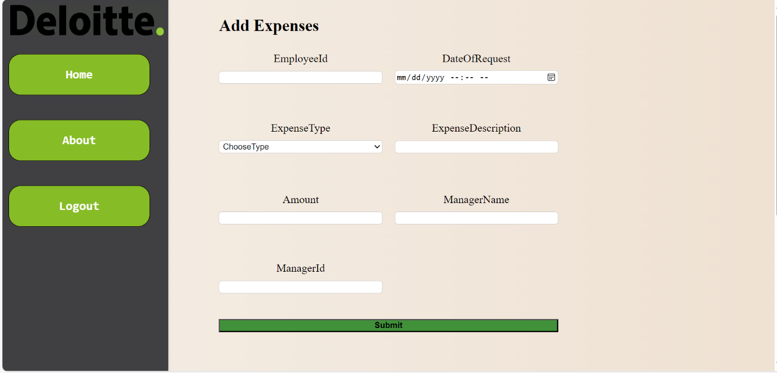
Snapshots

Slide 11
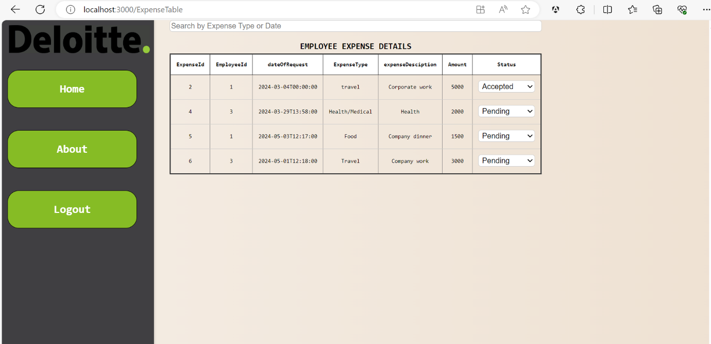
Snapshots

Slide 12
Professional learning
SQL Oracle
MS SQL Server
.NET Foundations
.NET Advanced
AngularJS
React.js

Slide 13
Work Plan
Start Date | End Date | Action
16/1/24 | 22/1/24 | Learning and Trainings on SQL and SSMS
23/1/24 | 5/2/24 | Learning and Trainings on .NET Foundation.
6/2/24 | 29/2/24 | Learning and Trainings on Advanced .NET and developing a practice project in .NET Core MVC.
1/3/24 | 25/3/24 | Learning and Trainings on ReactJS, Angular and developing a practice project in ReactJS
26/3/24 | 30/3/24 | Developing database and backend APIs.
31/4/24 | 5/4/24 | Developing UI Components using ReactJS
6/4/24 | 8/4/24 | Integration of frontend with backend APIs

Slide 14
Key Highlights
Employees can create new expense requests, edit, search expenses and delete existing pending expense requests.
Once Manager logs in, he/she will be able to see the expense requests of respective user in the form of a hyperlink.
Managers can review and approve/reject expense requests
Employee landing/home page to have details of all the expense requests raised by him/her in the past.

Slide 15
Video

Slide 16
Feedback
Invaluable experience that provided hands-on learning and practical exposure to real-world scenarios.
Bridged the gap between theoretical knowledge and practical application.
The training enhanced my technical skills of SQL, .NET, Angular and React.
It improved my problem-solving abilities and teamwork skills, as I collaborated with peers on various tasks and projects.
The faculty visit emphasized the importance of continuous learning and staying updated with industry trends, which was very motivating.

Slide 17
Thank You

